Slide 1
Electronic Instrumentation Section-1, Ppt-6

Slide 2
Cathode Ray Oscilloscope (CRO)

Slide 3
Definition: The cathode ray oscilloscope (CRO) is a type of electrical instrument which is used for showing the measurement and analysis of waveforms .
It is a very fast X-Y plotter shows the input signal versus another signal or versus time. The CROs are used to analyse the waveforms, transient, phenomena, and other time-varying quantities from a very low-frequency range to the radio frequencies.

Slide 4
Construction of Cathode Ray Oscilloscope
The main parts of the cathode ray oscilloscope are as follows.
Cathode Ray Tube
Electronic Gun Assembly
Deflecting Plate
Fluorescent Screen For CRT
Glass Envelop

Slide 5
1. Cathode Ray Tube
The cathode ray tube is the vacuum tube which converts the electrical signal into the visual signal. The cathode ray tube mainly consists the electron gun and the electrostatic deflection plates (vertical and horizontal).The electron gun produces a focused beam of the electron which is accelerated to high frequency.

Slide 6
2. Electronic Gun Assembly
The electron gun emits the electrons and forms them into a beam. The electron gun mainly consists a heater, cathode, a grid, a pre-accelerating anode, a focusing anode and an accelerating anode.
After the emission of an electron from the cathode grid, it passes through the control grid. he control grid is usually a nickel cylinder with a centrally located co-axial with the CRT axis. It controls the intensity of the emitted electron from the cathode.

Slide 7
The electron while passing through the control grid is accelerated by a high positive potential which is applied to the pre-accelerating or accelerating nodes.
The electron beam is focused on focusing electrodes and then passes through the vertical and horizontal deflection plates and then goes on to the fluorescent lamp.

Slide 8
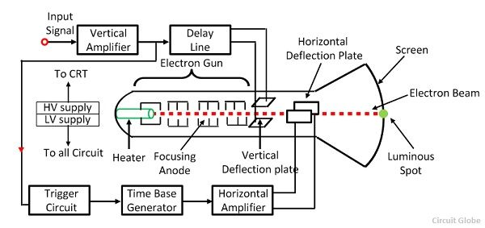

Slide 9
CRT
3. Deflecting Plate
The electron beam after leaving the electron gun passes through the two pairs of the deflecting plate. The pair of plate producing the vertical deflection is called a vertical deflecting plate or Y plates, and the pair of the plate which is used for horizontal deflection is called horizontal deflection plate or X plates.

Slide 10
4. Fluorescent Screen for CRT
The front of the CRT is called the face plate. It is flat for screen sized up to about 100mm×100mm. The screen of the CRT is slightly curved for larger displays. The face plate is formed by pressing the molten glass into a mould and then annealing it.
The inside surface of the faceplate is coated with phosphor crystal. The phosphor converts electrical energy into light energy. When an electronics beam strike phosphor crystal, it raises their energy level and hence light is emitted during phosphorous crystallisation. This phenomenon is called fluorescence.

Slide 11
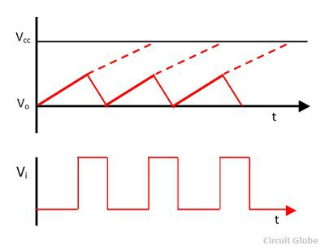
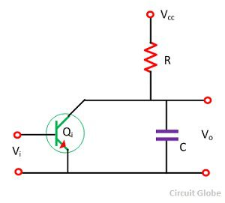

Time Base Generator
The generator which is used for generating the linear variable voltage concerning time is known as the time base generator.

Slide 12
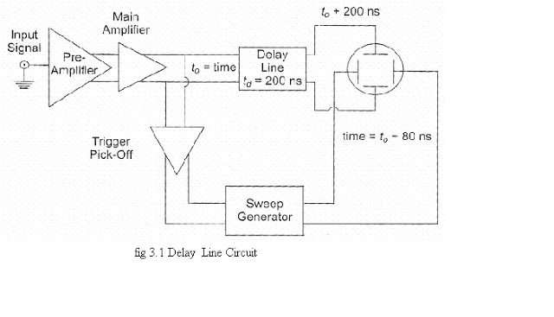
FUNCTION OF DELAY LINE

Slide 13
Working of Cathode Ray Oscilloscope
When the electron is injected through the electron gun, it passes through the control grid. The control grid controls the intensity of electron in the vacuum tube.
If the control grid has high negative potential, then it allows only a few electrons to pass through it. Thus, the dim spot is produced on the lightning screen. If the negative potential on the control grid is low, then the bright spot is produced. Hence the intensity of light depends on the negative potential of the control grid.

Slide 14
After moving the control grid the electron beam passing through the focusing and accelerating anodes. The accelerating anodes are at a high positive potential and hence they converge the beam at a point on the screen.

Slide 15
Basic Controls of Cathode Ray Oscilloscope
Position Control: The position control knob in the oscilloscope is used for controlling the position of the bright spot from left to right. By adjusting the knob, we can easily control the position from left to right.
Brightness Control: The brightness of the beam is directly dependant on the intensity of the electrons. The control grids are responsible for the intensity of the electron in the electron beam. Therefore, by controlling the grid voltage, we can adjust the brightness of the electron beam

Slide 16
Focus Control: The focus control can be attained by adjusting the voltage applied to the middle anode of the cathode ray tube. The middle anode and the other two anodes around it form the electrostatic lens. Thus, the focal length of the lens can be adjusted by controlling the voltage across middle anode.

Slide 17
Applications of CRO
Voltage measurement
Current measurement
Examination of waveform
Measurement of phase and frequency
Uses of CRO
In laboratory, the CRO can be used as
It can display different types of waveforms
It can measure short time interval
In voltmeter, it can measure potential difference

Slide 18
CRO stands for __________ a) Cathode Ray Oscilloscope b) Current Resistance Oscillator c) Central Resistance Oscillator d) Capacitance Resistance Oscilloscope

Slide 19
C.R.O gives __________ a) actual representation b) visual representation c) approximate representation d) incorrect representation

Slide 20
Oscilloscope is __________ a) a ohmmeter b) an ammeter c) a voltmeter d) a multimeter

Slide 21
Electron beam is deflected in __________ a) 1 direction b) 4 directions c) 3 directions d) 2 directions

Slide 22
CRO can’t display microseconds time. a) True b) False

Slide 23
. Typically oscilloscope represents __________ a) current and time b) resistance and time c) voltage and time d) power and time

Slide 24
1. By making use of a CRO _________ a) many characteristics of a signal can be measured b) only a few characteristics of a signal can be measured c) no characteristics of a signal can be measured d) signal can only be displayed

Slide 25
How is frequency related to time period? a) square proportional b) not related c) directly proportional d) inversely proportional

Slide 26
8. Period of a waveform is obtained by which of the following relation? a) T = number of divisions occupied by 1 cycle×(time) b) T = number of divisions occupied by 1 cycle×(¹⁄_{division}) c) T = number of divisions occupied by 1 cycle×(^{time}⁄_{division}) d) T = number of divisions occupied by 1 cycle

Slide 27
Thank you

